Slide 1
Linear Regression - Using Sklearn
Made by : Afroz Chakure

Slide 2
Outline
How does Supervised Learning work ?
What is Linear Regression ?
Different types of Linear Regression
Equation for Simple Linear Regression
Equation for Multiple Linear Regression
Ordinary Least Squares
Assumptions in Linear Regression.

Slide 3
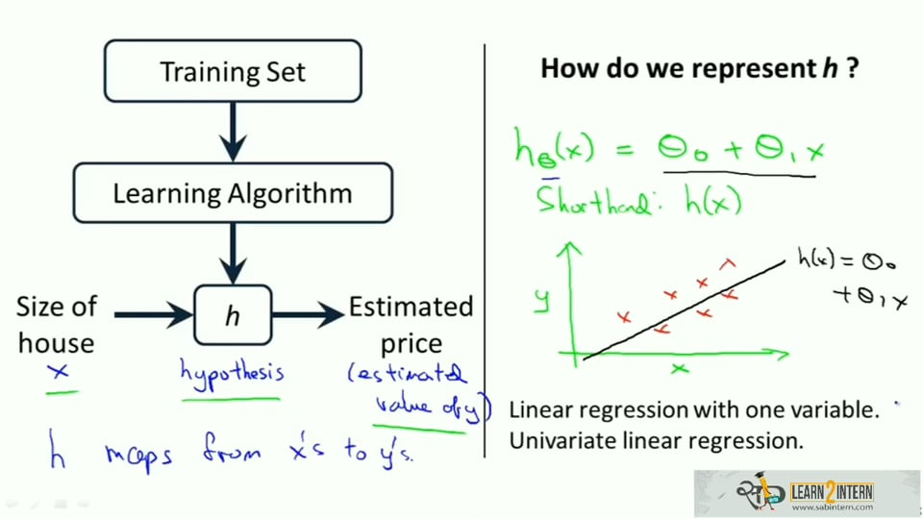
How does Supervised Learning work ?
In Supervised Learning, our goal is, given a training set, to learn a function h:x y so that h(x) is a ‘good’ predictor for the corresponding value of y.
y = h(x)

Slide 4
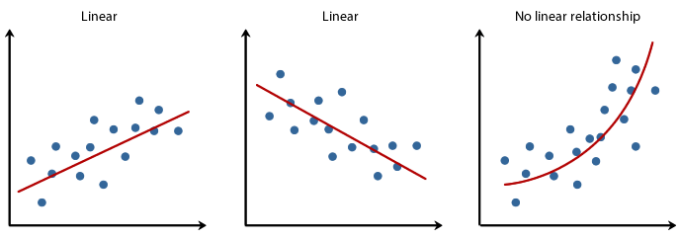
What is Linear Regression ?
Regression is a parametric technique used to predict continuous dependent variable given a set of independent variables.
A linear regression model attempts to explain the relationship between one or more variables using a straight line.

Slide 5
Different types of Linear Regression
Simple Linear Regression
Multiple Linear Regression
Simple Linear Regression (SLR) is a regression model where we have a single independent variable.
In Multiple linear regression (MLR) we have two or more independent variables and a dependent variable.

Slide 6
Equation for Simple Linear Regression
Mathematically, Simple Linear Regression can be represented by the equation
Y = βo + β1X + ∈
Where, βo and β1 are known as coefficients
Y - Dependent variable (variable we predict)
X - Independent variable (variable we use to make predictions)
βo - Intercept (Prediction value we get when X = 0)
β1 - Slope (Explains the change in Y when X changes by 1 unit)
∈ - Error (represents residual value i.e. Difference between actual and predicted values)

Slide 7
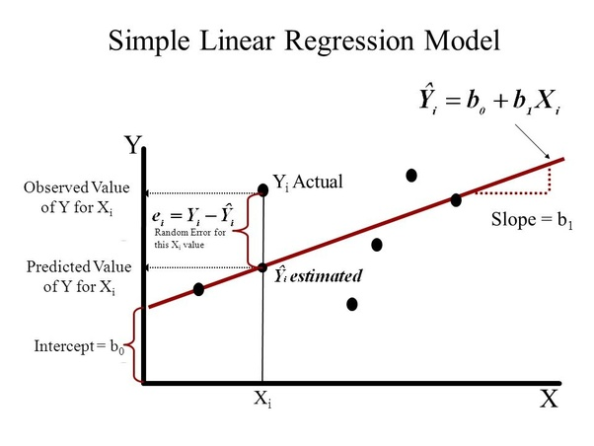

Slide 8

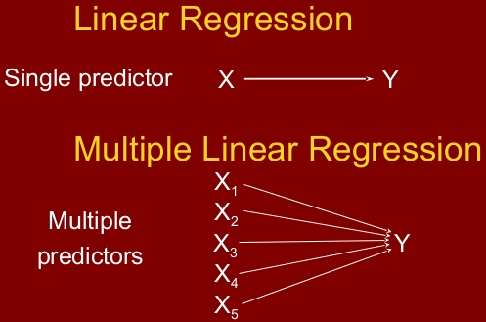
Multiple Linear Regression
In higher dimensions when we have more than one input (x), the line is called a plane or a hyper-plane.
Equation for Multiple Linear Regression is given by :

Slide 9
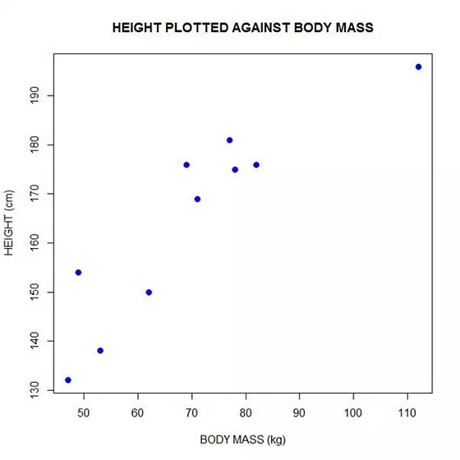
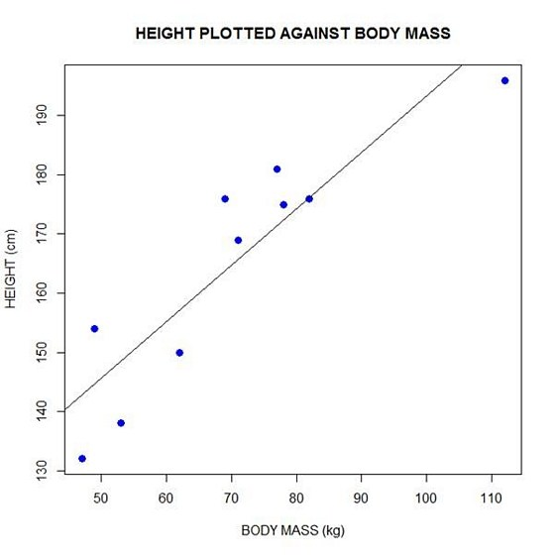
Objective of Linear Regression
The objective of Linear Regression is to get the best possible line.
The best possible line will be such that the average squared vertical distances of the scattered points from the line will be the least.
Ideally, the line should pass through all the points of our training data set
Notes:
But it doesn’t really happen in real life scenarios

Slide 10
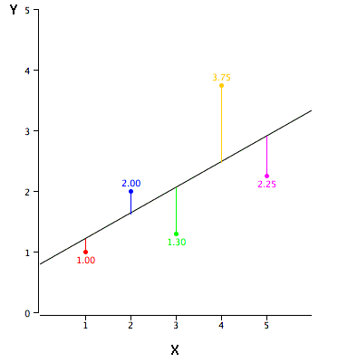
Linear Regression using a Plot
The black diagonal line in the figure is the regression line and consists of the predicted score on Y for each possible value of X.
The vertical lines from the points to the regression line represent the errors of prediction.
But,
How do we know that a given regression line is the best fit line ?

Slide 11
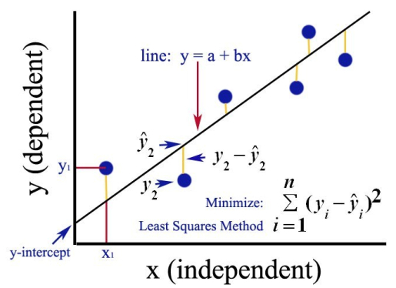
Ordinary Least Squares
The Ordinary Least Squares (OLS) technique tries to reduce the sum of squared errors ∑[Actual(y) - Predicted(y')]² by finding the best possible value of regression coefficients (β0, β1, etc).

Slide 12
Assumptions of Linear Regression
There must be a linear relationship between the dependent and independent variables.
Sample observations are independent.
Error terms are normally distributed with mean 0.
No multicollinearity - When the independent variables in my model are highly linearly related then such a situation is called multicollinearity.
Error terms are identically and independently distributed. (Independence means absence of autocorrelation).
Error terms have constant variance i.e. there is no heteroscedasticity.
No outliers are present in the data.

